Slide 1
ENGI 301 Sun Clock PCB Proposal
11/26/2019
Annabel Chang

Slide 2
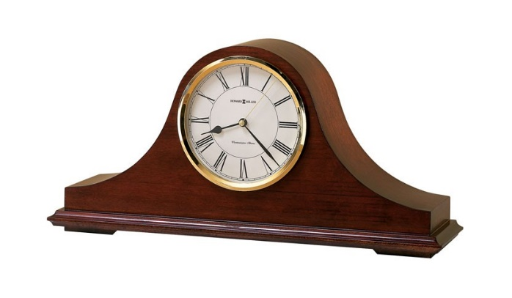


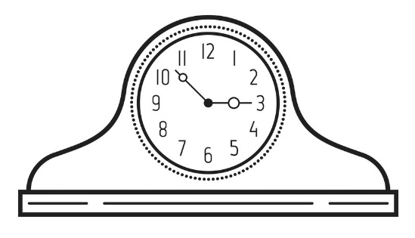

Background Information
What is being proposed?
Clock that shows the position of the sun and has a screen display of time; alarm can be set by user through mode, hour, and minute buttons
Pictures:
What improvements / additions over existing project
No need to reset time after battery death due to RTC; visualization of time through moving sun; set alarm function
(moon will rotate up during night)
-> Sun is up during day
-> screen

Slide 3
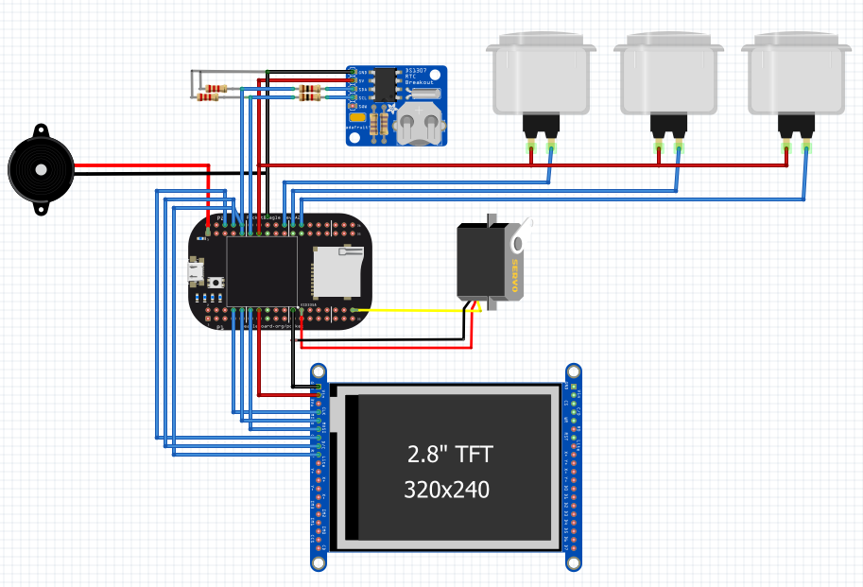
System Block Diagram
RTC DS1307
I2C1
Buttons
GPIO 64, 46, 48
1kΩ Resistor
Speaker
1536
PWM1
22kΩ Resistor
Servo FS5103R
PWM0
PocketBeagle
Touch screen ILI9341
SPI0

Slide 4
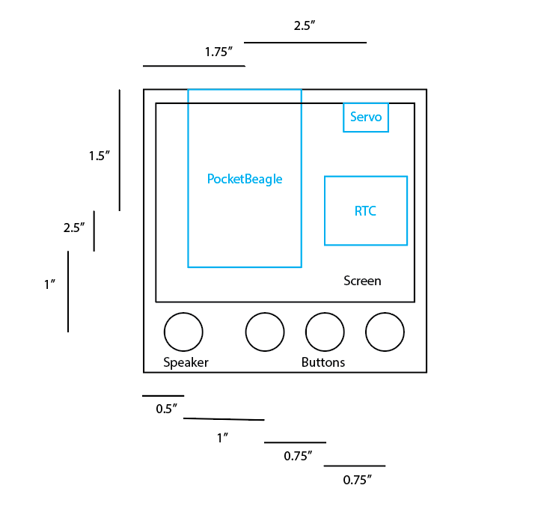
PCB Diagram
3.5 x 3.5 board
*Black: Front
*Blue: Back

